Slide 1

DESIGN AND IMPLEMENTATION OF A SMART ITEM RECOVERY ECOSYSTEM WITH DONATION INTEGRATION
Faculty of computing
Department of Software Engineering
Supervised by:
Mr. Austin Ogar
Presented by:
Ummusulaim Usman 20221020, Taofeek Ayanwale 20220372, Adil Ahmad-Rufai 20220860, Mahmud Rufai Sule 20221928, Ugavah Okeoghene 20220806, Abdulmuheed Ataba Abdulazeez 20220519

Slide 2
TABLE OF CONTENT
1 | Background of study
2 | Problem Statement
3 | Related Works
4 | Significance of Study
5 | Aim and Objectives
6 | Research Process
7 | Methodology
8 | Development Environment and Tools
9 | Development plan
10 | References

Slide 3
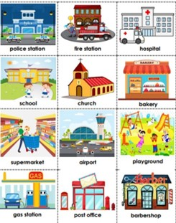


BACKGROUND OF STUDY
Item recovery systems have long played an essential role in places within communities by managing misplaced belongings.
Most Universities still rely on manual methods which has proven to be inefficient in managing lost and found items.
Smart item recovery ecosystem with donation integration.

Slide 4
PROBLEM STATEMENT
CHALLENGE
IMPACT
LIMITATIONS
Manual administrative process.
Poor communication Channels.
Poor management of unclaimed items.
Slow and inefficient system
Low recovery success rate.
Wastage.
Lack of an automated system.
Lack of an efficient system to manage unclaimed items.
The challenges can be solved by developing a Smart Item recovery Ecosystem with donation Integration.

Slide 5
Related Works
S/N | Title of Paper | Author(s) | Year | Methodology | Findings | Limitations
1 | Helping Hand: An Interactive Mobile Application Featuring Underprivileged People Assistance With Donation and Beneficiary Selection Facilities | Mahfuzulhoq Chowdhury, Alve Ahmad(2023) | 2023 | Waterfall methodology | Developed an interactive mobile application aimed at assisting underprivileged people through a donation-based support system. | Focuses only on donation. Lacks item recovery ecosystem.
2 | AppalLOCATE: A Lost and Found Solution | Derek Clark Wilson(2023) | 2023 | Hybrid web/mobile app design with contextual search | Combined location-based tracking with item database. | Prototype only. Lack of proper implementation.
3 | An Effective Lost and Found System in University Campus | Siok Yee Tan & Cia Rui Chong(2023) | 2023 | PHP, MySQL, and web development | Enhanced authentication and reporting accuracy on campus. | Limited external applicability.
4 | Web-Based Lost and Found System | Satendra Kumar et al.(2022) | 2022 | Web portal using HTML, PHP, and MySQL | Simplified reporting and recovery through a centralized database. | Lack of automated item verification (Manual verification).

Slide 6
Related Works
S/N | Title of Paper | Author(s) | Year | Methodology | Findings | Limitations
5 | Development of User-Friendly Web-Based Lost and Found System | Khairunnahar Suchana et al.(2021) | 2021 | Web app development, usability testing | Developed an efficient online reporting and retrieval system for lost items. | Limited to web application.
6 | An effective lost and found system in university campus | S. Y. Tan & C. R. Chong(2023) | 2023 | analysis of the pretesting, functional requirement, and system model | The system successfully helped the students and staff of UKM to find their lost belongings and items faster and easier | mobile application is exclusive to Android devices, limited accessibility,
7 | LostNet: A Smart Way for Lost and Find | Meihua Zhou et al.(2023) | 2023 | Deep learning (MobileNetV2 + attention mechanism) | Achieved 96.8% accuracy for image-based item retrieval. | Focuses only on visual recognition and lacks donation integration.
8 | Design and Implementation of a Lost but Found Mobile app: A case Study for Nile University | Fatima Yahaya(2025) | 2025 | Mobile app development using React(native,) node.js, MongoDB | Developed a mobile system to assist individuals in locating lost items | Lacks integration of donation system to manage unclaimed items. Lacks AI image recognition.

Slide 7
GAPS IN LITERATURE
Lack of Integration Many existing systems focus only on item recovery or donation and not both.
Absence of Smart Features
Features like AI image recognition are often missing in traditional item recovery systems.

Slide 8
AIM AND OBJECTIVES
The aim of our project is to develop a Smart Item Recovery Ecosystem with Donation Integration.
The aim of this project will be achieved through the following specific objectives:
Objective 1
Objective 2
Objective 3
To design a Smart item recovery ecosystem with donation integration.
To implement the first Objective.
To test the system to ensure that it satisfies all functional and non-functional requirements.

Slide 9

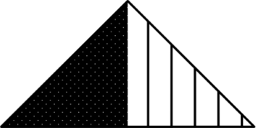
RESEARCH PROCESS
Mixed Method
Quantitative
Qualitative
Numbers and data to measure
system usage and performance
User feedback to understand
experience and improve design.

Slide 10
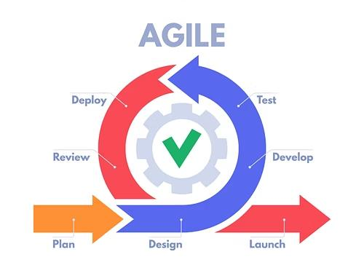
METHODOLOGY

Slide 11
Development Environment and Tools
FRONTEND
BACKEND
DATABASE
Flutter
Dart
Firebase

Slide 12
Development plan
Phase | Duration | Key Activities
Requirements Analysis | Week 1–2 | Stakeholder interviews, literature review
Design | Week 3–4 | System architecture, UI/UX mockups
Implementation Sprint 1 | Week 5–6 | User registration and item reporting
Implementation Sprint 2 | Week 7–8 | AI-image recognition module
Implementation Sprint 3 | Week 9–10 | Donation listing and claim module
Testing & Debugging | Week 11–12 | Usability testing, performance evaluation
Deployment & Evaluation | Week 13–14 | Pilot deployment, feedback collection
Documentation and Wrap-up | Week 15 | Final report, user manual, project handover

Slide 13
CONCLUSION
This project demonstrates the practicality and benefits of automating Nile university’s item recovery process.

Slide 14
REFERENCES
Chowdhury, M., & Ahmad, A. (2023). Helping Hand: An Interactive Mobile Application Featuring Underprivileged People Assistance With Donation and Beneficiary Selection Facilities. 1–6
Wilson, D. C. (2025). AppalLOCATE: A Lost and Found Solution (Doctoral dissertation, Appalachian State University).
Tan, S. Y., & Chong, C. R. (2023). An effective lost and found system in university campus. Jistem Journal of Information Systems and Technology Management
Kumar, S., Bhatnagar, D., Gahlot, D., Gola, B. S., & Rajput, G. (2022). Web-Based Lost and Found System. MIT International Journal of Computer Science and Information Technology, 11(1).

Slide 15
REFERENCES
Suchana, K., Alam, S.M.E., Meem, A.T., Turjo, M.D. and Khan, M.M., 2021. Development of User-Friendly Web-Based Lost and Found System. Journal of Software Engineering and Applications, 14(10), pp.575-590.
Tan, S. Y., & Chong, C. R. (2023). An Effective Lost And Found System In University Campus. Journal of Information System and Technology Management, 8(32), 99-112.
Zhou, M., Fung, I., Yang, L., Wan, N., Di, K. and Wang, T., 2023. LostNet: A smart way for lost and find. arXiv preprint arXiv:2301.02277.

Slide 16
Thank You
Any Questions

